Slide 1
Distinctive attributes affecting the Interest about a team
and its Popularity
Case Study: Barclays Premier League 2015 – 2016
Group 3
Oduntan Oluwagbemiga Kolawole oko1n14
Napoleon Koskinas nk5g15
Abdollah Afdel aa28g151
Pengfei Gao pg6g15
Emmanouil Petsanis ep1g15
Project Supervisor: University of Southampton
Elena Simperl Foundations of Data Science

Slide 2
Aim of Application
Our idea is to associate the features of play of a team with the interest about that team and its popularity.
Interest can be defined as the need of people to learn latest news about an entity.
Popularity is defined as the state of being liked or supported by people.
Features of Play (about football) are measures which define a team’s way of playing, and are functions of statistical outcomes produced during a match by a team.

Slide 3
Motives for Research
Higher interest about the team could potentially lead to financial revenue raise in the long term:
Advertisements
Sales: Team kits , tickets
TV contracts
Potential users of the application are marketing managers of teams that are interested to predict income and decide strategies in negotiating TV or sponsorship deals.

Slide 4
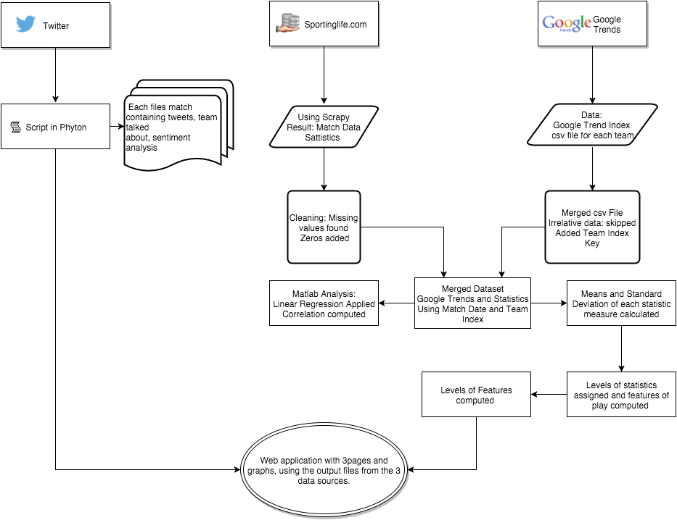
Application Pipeline

Slide 5
Data Sources and Tools Used
Match Statistics data(goals, shots on goal, corners) are retrieved from www.sportinglife.com using Scrapy.
Google Trends index data is downloaded as a measure of interest about a team.
Twitter was used as a data source to define the popularity of a team, comparing the positive and negative tweets.”tweepy” library was used to implement the Twitter API and download relevant tweets.
Data Cleaning was implemented using python scripts which dismiss irrelevant data, add the right values where there are missing values.
Preprocessing datasets using python to fit the desired format for analysis(.csv) and visualization (.json).
MatLab used to analyze data, find means-standard deviation of statistics and features, and search for correlation and linear regression relationship.
D3.js used to visualize results.

Slide 6
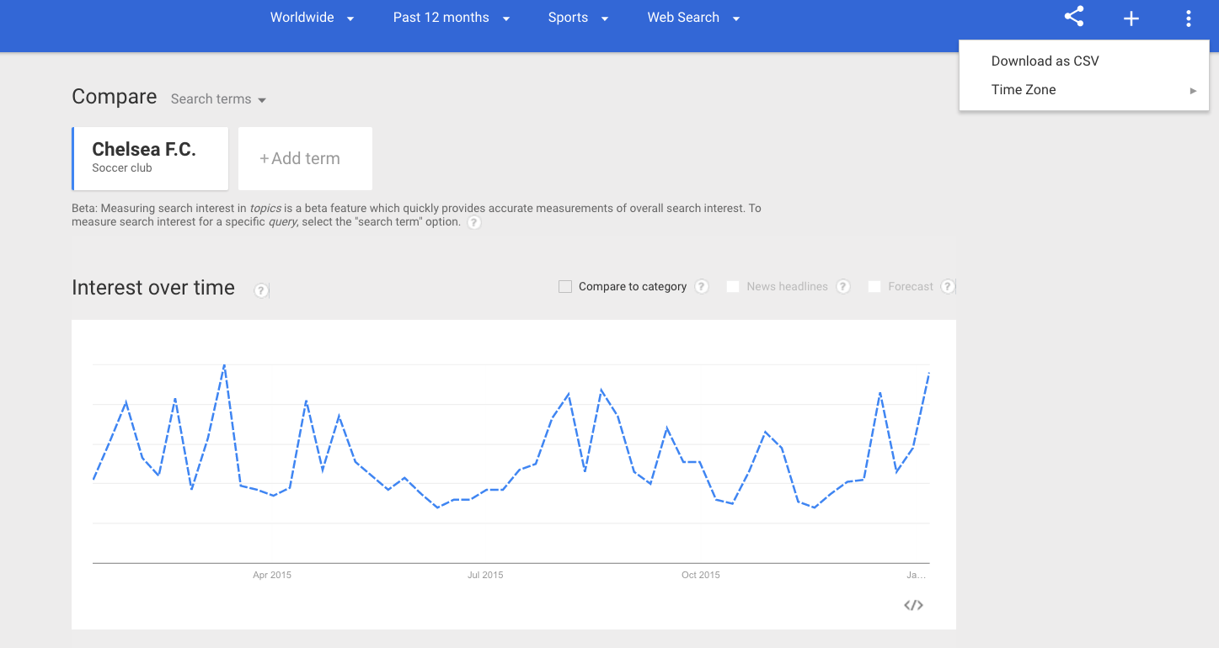
Data Collection from Google Trends
Search by :
Official name of each premier league team(e.g. Chelsea F.C).
For last 12 months
Google Trends Index per week
Categories: Sports
Download as csv file, one per team

Slide 7
Data Collecting from Twitter
Search Tweets for each match by :
Hashtag containing teams’ official abbreviations
Match start date, Match start time , end of collection time
For example search for Manchester United vs Chelsea match by hashtag(#MUNCHE and #CHEMUN) on 2015-12-28 at 17.30 stop collecting Tweets on 2015-12-29 at 05.30

Slide 8
Tweets Analysis
Using training sets containing keywords relevant to each team to train a Bayes Naive Classifier for each team.
For each match create a file which includes the tweets with the team referring to, according to the classifier
Tweets that are relevant to both teams or irrelevant to football match are ignored
The tweets are labelled as positive or negative using a trained Bayes Naive Classifier for sentiments.

Slide 9
Data Cleaning-Preprocessing-Merging
Google Trends
Assign a unique numeric key value (1-20) to each team
Merge 20 files into one. Dismiss data not needed for our goal (for example location of origin of search).
Statistics
Scrapper did not return a statistic key-pair value if the stats value was 0
For a missing statistic value we added key-value pair with value 0
Adjusted the date format of statistics dataset to format(YYYY-MM-DD), in order to match Google Trends Index corresponding to the week containing the date of every match. The other criteria used to match two datasets was teamNo. Google Trends Indices about weeks not containing a match were skipped.

Slide 10
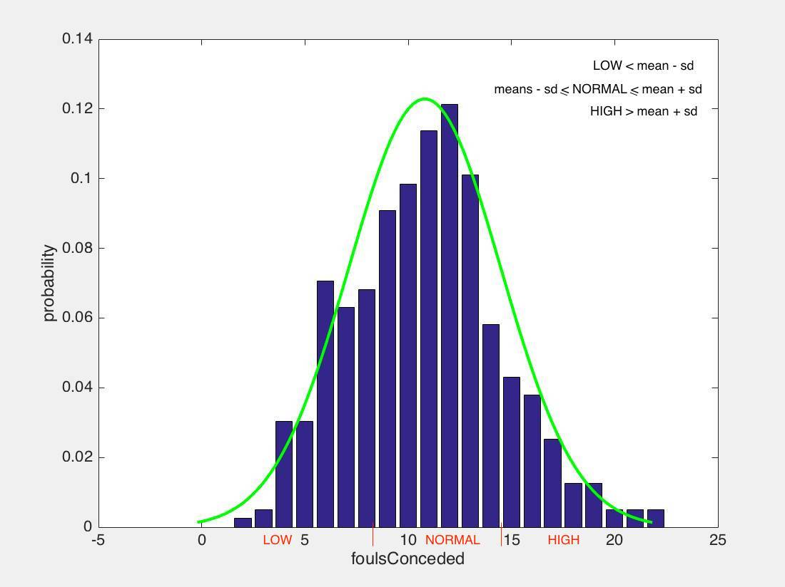
Statistics Classifying
Due to the fact that the statistics have different scale we classify them in three different levels :
Levels: Low , Normal , High corresponding to numeric values 1, 2, 3 respectively.
We use mean and standard deviation of each statistic to define the levels.

Slide 11
Analysis Methods
1. Linear Regression (For statistics)
Linear Regression is aimed to calculate how the features are related to interest about a team.
Use only statistics to predict the popularity. The plot of prediction of test set and original popularity is shown right hand side.
It is obvious that this model can not represent data properly, probably because it is too simple(missing factors that play a role in response value).

Slide 12
Defining Features Of Play
Accuracy = sum (level Of (Shots on Target,accurate passes, -offsides))
Attack= sum (level Of (Shots on Target, Shots off Target ,corners, goals, fouls Won ,offside ))
Aggressiveness=sum (level Of (fouls Conceded ,yellow cards))
Pressure = sum (level Of (Shots Off Target, Corners , Possession ))
Team Play = sum (level Of (Passes , Accurate Passes , Possession ))

Slide 13
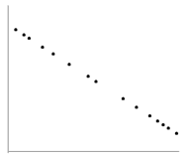
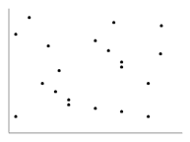
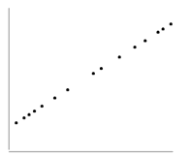
Analysis Methods Cont.
2. Person Correlation (For features)
Person correlation is a method, which investigates the relationship between two significant, continuous variables. Person correlation coefficient is a measure of the strength of the association between two variables.
r=-1
r=0
r=1

Slide 14
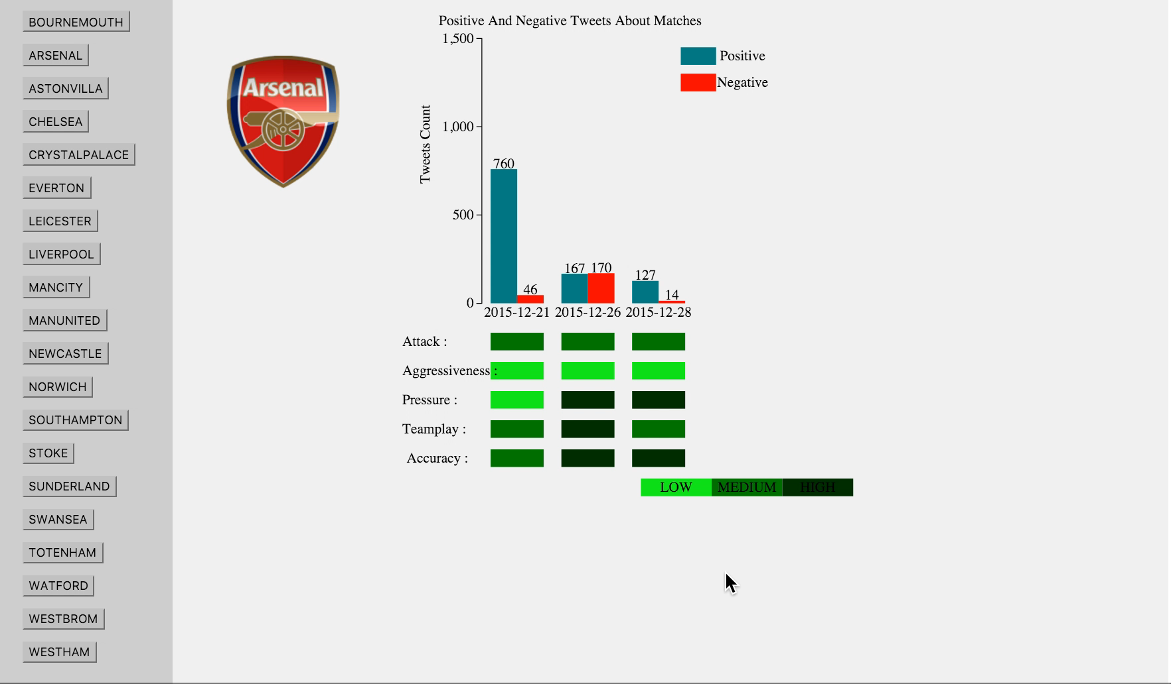
Data Visualization

Slide 15
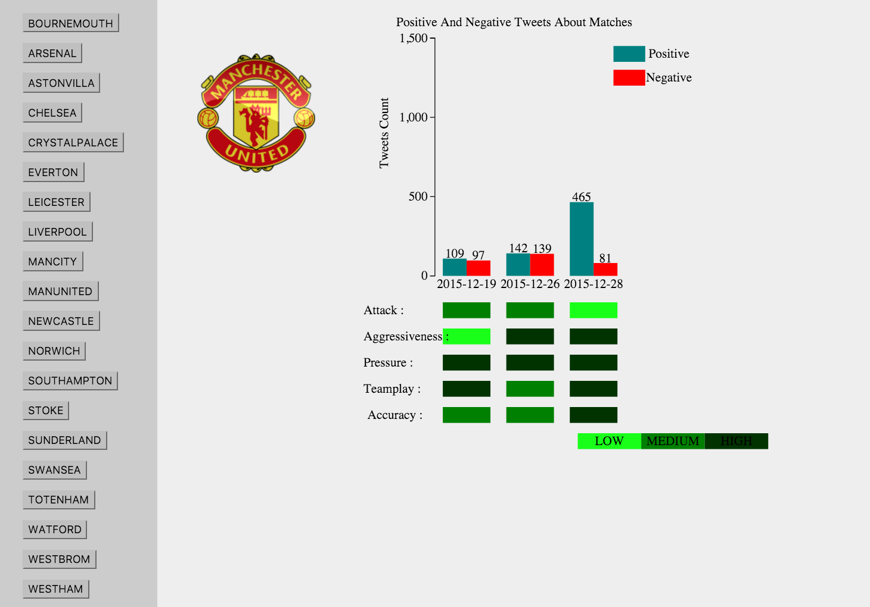
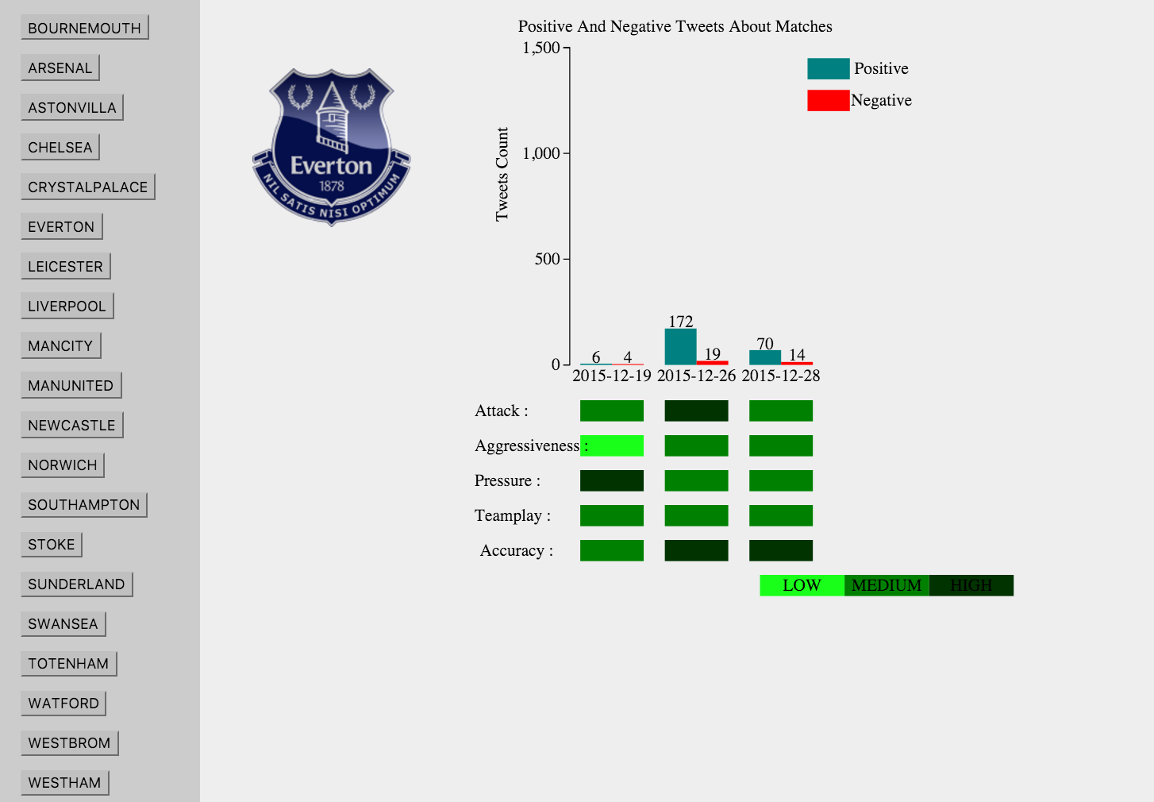
Observations
Level of Aggressiveness with the number of positive tweets

Slide 16
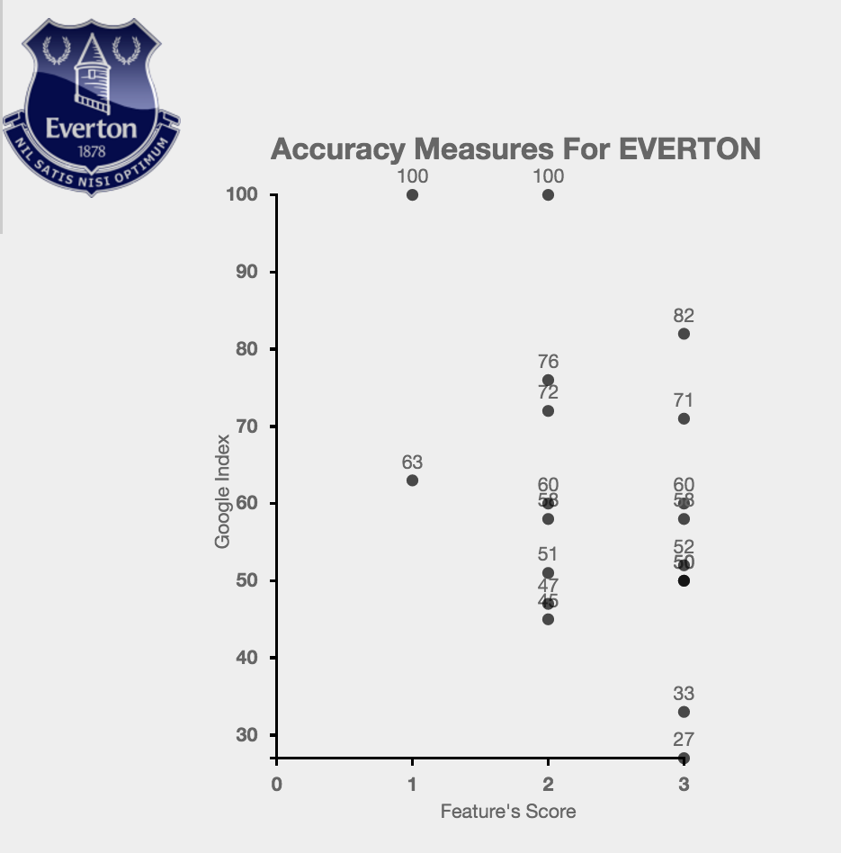
Observations
Google Trends Index values do not to follow a
pattern as they would if there was a correlation.

Slide 17
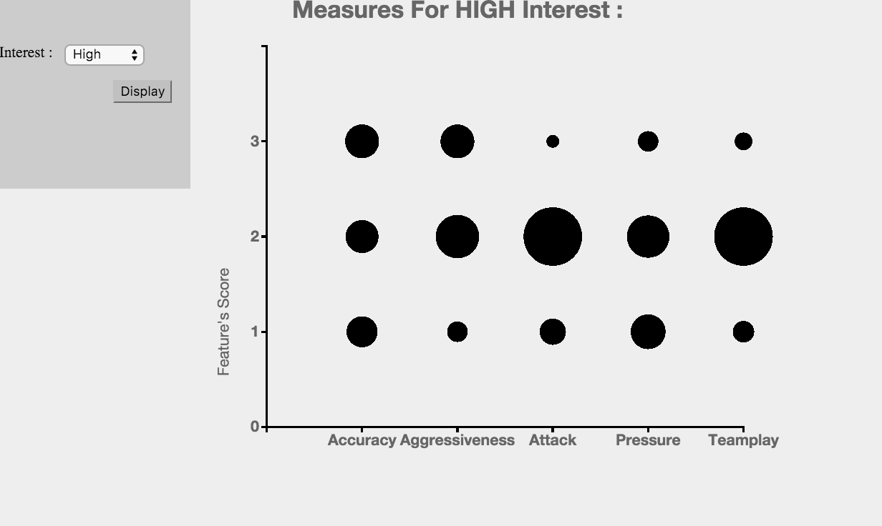
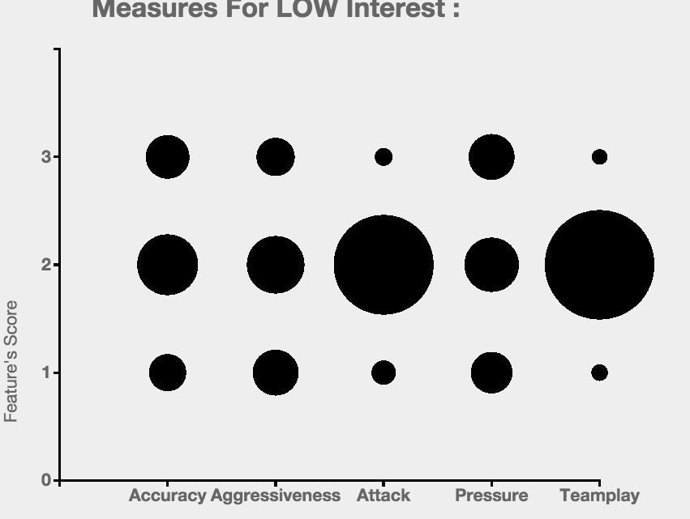
Observations
Observations with the same score of 2

Slide 18
Thoughts
We saw that the features we used have no correlation with the interest and popularity so there must be other factors:
We made an observation from the Tweets that people talk a lot about the big teams for example (Man United lost against Norwich city and people were talking about Man United than Norwich city that played well in that match)
Another example is that although recently Chelsea made their first win after some months , and their popular ex-coach had been sacked some days before that, fans still criticized the team despite their win.

Slide 19
THANK YOU!
Github Repository link to project
https://github.com/koskinap/Popularity_StyleOfPlay_DS2015_Group3_Soton

